Slide 1


Adaptive Cards
Community call
Handling multi-user responses for Adaptive Cards in Teams 🆕
Microsoft Build 2022 🎉
Call to Action 🤝
Q&A ❔
Josh Friedman Microsoft
J.P. Roca Microsoft
May 12, 2022

Slide 2
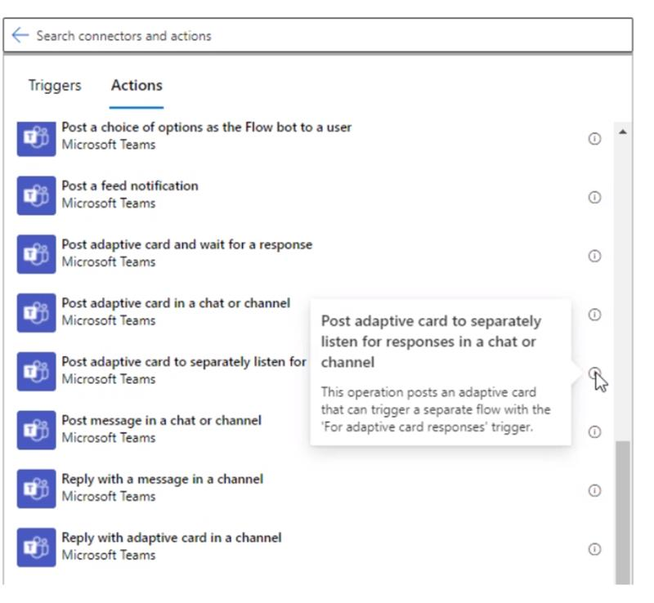
Handling multi-user responses for Adaptive Cards in Teams 🆕
Notes:
I wanted to give you all a recap on Viva Connections, and how the Adaptive Card framework plays a big role in the extensibility world of Viva Connections, for both 1P and 3P components and how the devs can use that to extend VC experience in the dashboard.

Slide 3
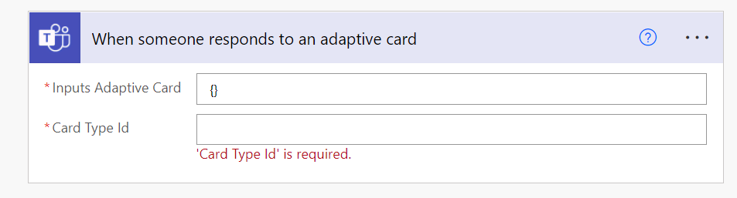
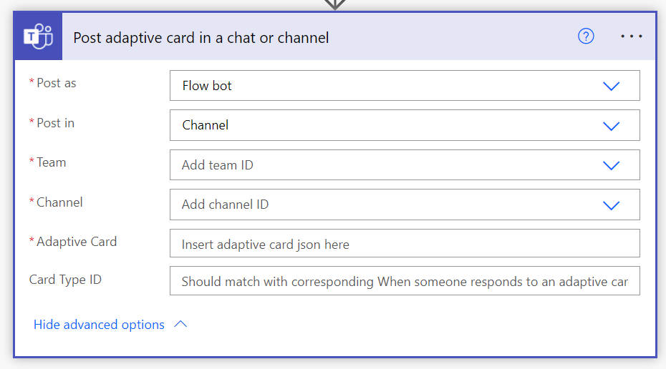
Trigger and Action – Two separate flows
Response Handling Flow
Card Posting Flow
Card Type IDs must match exactly
Adaptive cards must take the same inputs
Card Type IDs support many to many relationship
Can post multiple cards with the same ID
And/Or have multiple response handlers with same ID

Slide 4
Microsoft Build 2022 🎉
What?
Yearly conference where we showcase the latest innovations in code and application development
Who?
Featured speakers representing your favorite tech at Microsoft (including Adaptive Cards 😉)
When?
May 24th - May 26th
Where?
Hosted online
How?
Register now to attend at aka.ms/build
Notes:
I wanted to give you all a recap on Viva Connections, and how the Adaptive Card framework plays a big role in the extensibility world of Viva Connections, for both 1P and 3P components and how the devs can use that to extend VC experience in the dashboard.

Slide 5
Call to Action 🤝
Please share your feedback!
2 question survey found at aka.ms/ACFeedback
Notes:
I wanted to give you all a recap on Viva Connections, and how the Adaptive Card framework plays a big role in the extensibility world of Viva Connections, for both 1P and 3P components and how the devs can use that to extend VC experience in the dashboard.

Slide 6
Q&A

Slide 7
Resources
Let us know the features you need https://aka.ms/ACRoadmap
Get started with Templating https://aka.ms/ACTemplating
Browse the Adaptive Cards Code https://aka.ms/ACRepo
Find tools, sample cards and more https://www.madewithcards.io

Slide 8
Microsoft 365 developer community calls
Microsoft 365 platform call (weekly) https://aka.ms/m365-dev-call
Adaptive Cards (monthly) https://aka.ms/adaptivecardscommunitycall
Microsoft identity platform (monthly) https://aka.ms/IDDevCommunityCalendar
Office Add-ins (monthly) https://aka.ms/officeaddinscommunitycall
Power Apps (monthly) https://aka.ms/PowerAppsMonthlyCall
Microsoft 365 Community (bi-weekly) https://aka.ms/m365-dev-sig
SharePoint Framework (bi-weekly) https://aka.ms/spdev-spfx-call
https://aka.ms/m365pnp

